Slide 1
Model Driven Forms: Tips and Tricks
Evan Wallace
@Evan_wa

Slide 2
What's in store
How to start using Model driven forms
What are some of the benefits over template driven?
A basic model driven form - Login
The bare bones of creating a model driven form
A more complicated form – Sign Up
Nested FormGroups
Native angular 2 validators
Custom Validators
Custom Control (the lazy way)
Custom Control again (the ControlValueAccessor way)
Form population from Remote source – Person details
Using the router to resolve data to populate your form
Keeping your form and model state in sync

Slide 3
How to include Model driven forms in your modules
Demo 1

Slide 4
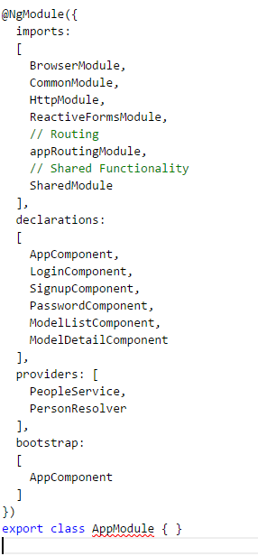
External Modules used by the AppModule
Components and directives within the AppModule
Injectable classes used in the scope of the AppModule
Tells Angular2 this is the Module to ‘boot’ in main.ts

Slide 5
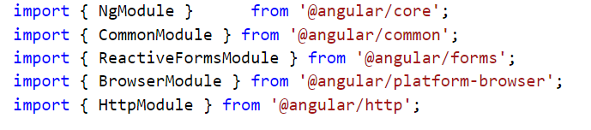
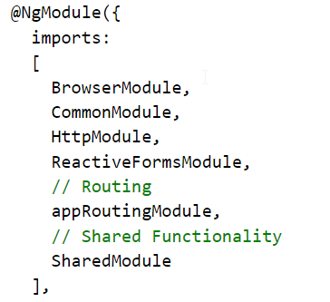
This import allows the module to access all the dynamic form goodness

Slide 6
Basic Form Example - Login
Demo 2

Slide 7
Login Form Recap
login.component.ts
Form Builder injected into component
FormGroup created in constructor
Done in constructor so when HTML renders, the FormGroup is ready to be interperated
Controls initialized with a [‘’] value so there is an initial value to bind to
Null also works here, or any other default value your form may require
login.component.html
[FormGroup] added to form tag so HTML knows the form group you are binding to
FormControls bound to inputs via formControlName input
This is best used on simple forms that do not contain nested groups
Non-submit buttons are given the correct type of “button” to ensure their logic is not run when the form is submitted

Slide 8
Complicated Form Example – Signup
Demo 3

Slide 9
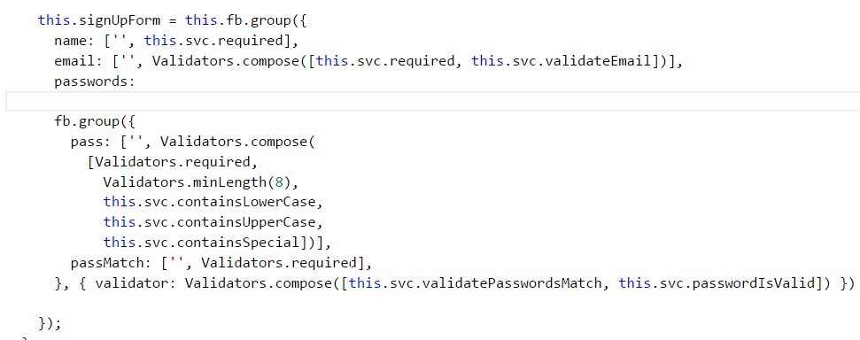
Nested Form Groups
Allows complicated form models to logically group controls together

Slide 10
Nested Form Groups cont.
Main benefits
Allows validation for a small section of the form
The example validates a password and re-typed passwords match
Syntax to access a nested Form Group’s control
singUpForm.controls[‘passwords’].controls[‘pass’]
Name of the Nested FormGroup
Name of the control within the Nested FormGroup

Slide 11
Native Angular 2 Validators
Imported via import { Validators } from ‘@angular/forms’;
Flavours
Required
Null
Min/Max length
Pattern (matches to a regex string)
Combine multiple validators to a single control using Validators.compse([validator1, validator2 …])

Slide 12
Custom Validators
Allows you to create your own validators for forms
Method that takes in the control
Does some logic to it
Return Null if the control passes validation
Return anything you like, but most examples I’ve seen { string: Boolean}
Eg { ‘Required’: true}
Can be used alongside the native validators

Slide 13
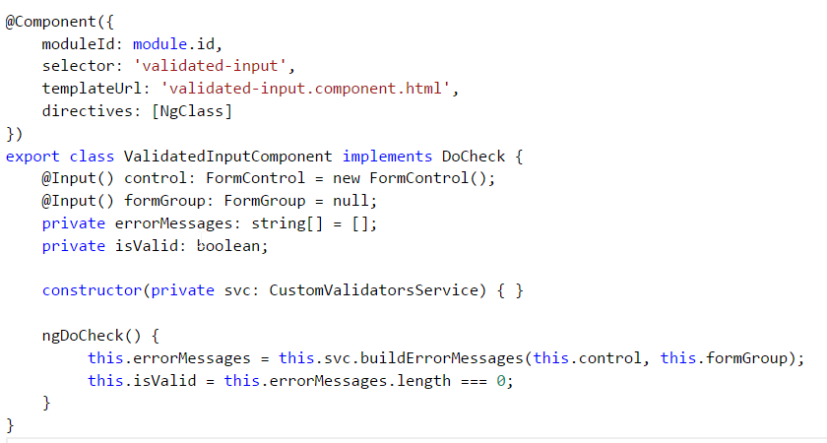
Lazy custom control
You are able to input the control into a component to then do additional processing or reduce duplicated code

Slide 14
Custom control – Using ControlValueAccessor
A bit more boilerplate in the implementation
A lot more extendable
Consider abstracting away boilerplate if you want to use this a lot
See stack overflow question link in ‘extra reading’ for more ideas with this

Slide 15
Sign Up Form Recap – Signup.component.ts
Much more complicated FormGroup created in constructor
All controls validated
Use Validators.Compose([validator1, validator2]) to combine validators
Able to use Prebuild Validators from @angular/forms or make custom ones
CustomValidatorService created to hold the logic of the form
Runs the validators as well as builds error list
FormGroup contained nested Groups
This is done to group logical functionality
Also provides a way to test validity across multiple controls as the validator for a group is run after the controls are rendered and validated

Slide 16
Sign Up Form Recap – Signup.component.html
Extra component used to help with validation
Using lazy way as well as the proper ControlValueAccessor
Shows how to access controls within nested FormGroups
signUpForm.controls[‘passwords’].controls[‘pass’]
Password component shows extra ways to present validation criteria (UX is a pretty big deal these days)

Slide 17
Building model from remote data source
Demo 4

Slide 18
Using Route resolver to populate data
Declare the resolver in routing
Accessed using the data property of ActivatedRoute
Careful with over using this
Resolver needs to finish before the page will be navigated to
Large lists or pages with a lot of details will be very sluggish
Use formGroup.patchValue() to update the form controls with the resolved data

Slide 19
Keep form and model in Sync
PatchValue only fires once in the constructor
Any changes to the form will cause the model and form to become out of sync
Because the brave new world of observables, we can do better!
AbstractControls has a property named ValueChanges that is an observable
You can subscribe to this observable to update your model when your form changes
Value changes can also be used on individual controls to extend functionality

Slide 20
Remote data source Recap
FormGroup created, the same was as the others
Data is resolved using the component router
Functions in constructor allow model and form to stay in sync

Slide 21
Extra reading
http://blog.thoughtram.io/angular/2016/03/14/custom-validators-in-angular-2.html
http://stackoverflow.com/questions/34948961/angular-2-custom-form-input
https://github.com/evkw/ng2meetup.FormsDemo

